Slide 1
Course Name: Computer Organization & Architecture
Course Code: CSE – 203
-Submitted by-
Abdullah Al Imran [ID No. 103014013]
Tasnuva Sultana [ID No. 112014017]
Sinthia Hamid [ID No. 103014022]
Fahad Zaman [ID No. 103014034]

Slide 2
Question No 1. What is Computer Organization?
Answer: Computer Organization refers to the level of abstraction above the digital logic level, but below the operating system level.
Five major subsystems:
Memory
Input
Output
Arithmetic-logic unit (ALU)
Control unit
Note: the ALU and control unit together are usually referred to as the central (CPU) or simply, the processor.

Slide 3
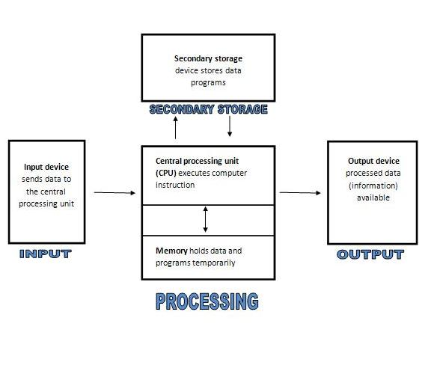
Picture: Diagram of computer architecture.

Slide 4
Question No 2. What is architecture?
Answer: In computer science and engineering, computer architecture refers to specification of the relationship between different hardware components of a computer system. It may also refer to the practical art of defining the structure and relationship of the subcomponents of a computer. As in the architecture of buildings, computer architecture can comprise many levels of information. The highest level of the definition conveys the concepts implement. Whereas in building architecture this over-view is normally visual, computer architecture is primarily logical, positing a conceptual system that serves a particular purpose. In both instances (building and computer), many levels of detail are required to completely specify a given implementation, and some of these details are often implied as common practice.

Slide 5
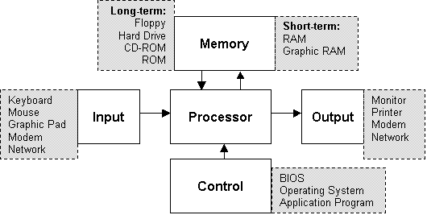
Picture: A single processor computer architecture.
.

Slide 6
Question No 3. What are the benefits of studying computer organization and compute architecture?
Answer:
Computer architecture is concerned with all aspects of the design and organization of the central processing unit and the integration of the CPU into the computer system itself.
It is impossible to design an operating system well without knowledge of the underlying architecture.
To explain how an instruction is fetched from memory and executed.
To articulate the strengths and weaknesses of the architecture.
Able to explain the relationship between the representations of machine level.
We can know operation at the binary level and their representation by a symbolic assembler.

Slide 7
Question No 4. What are the factors involve that prohibits us from spreading up?

Slide 8
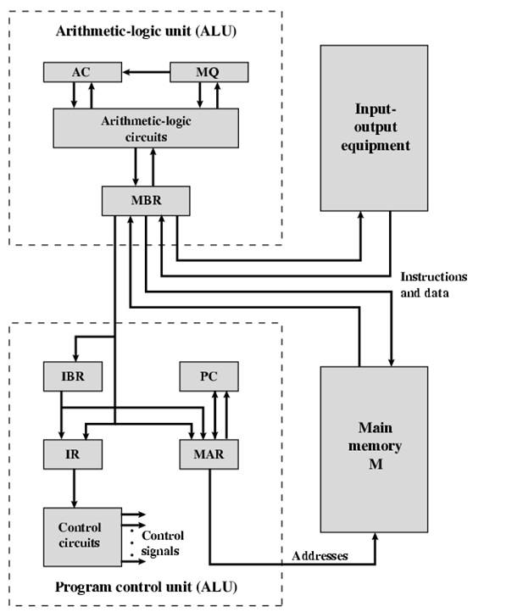
Picture: Structure of IAS

