Slide 1
Production and Consumption

Slide 2
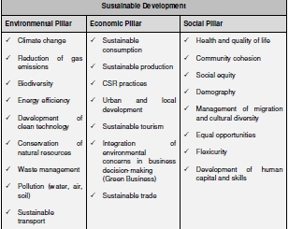

Slide 3
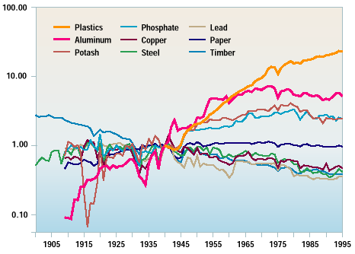
Materials: Intensity of Use
Notes:
From: Wernick, I.K., Herman, R., Rovind, S., and Ausubel, J.H. 1996
This figure illustrates the intensity of U.S. materials use from 1900-1990. Annual consumption data are divided by Gross Domestic Product (GDP) in constant 1987 dollars and normalized to unity in the year 1940. Notice how heavy materials such as steel, copper, lead, and lumber – all materials used for infrastructure – become less critical to economic growth over the course of this century.
Paper, by converting its role from manufacturing to information services,followed the economy closely. Use of light-weight materials such as aluminum and plastics has out paced economic activity since World War II.
Substances such as plastics represent an entirely new class of synthetic materials. Cheap and abundant fossil fuels combined with advances in physics, organic chemistry, and material science enabled us to create innovative materials previously unknown in the natural world. It is these materials, and their combinations, that allowed the development of the transistor, magnetic tape, fiber optics, and countless other objects we use in our daily lives. Developing these materials has given us a new economy, spread much prosperity and knowledge, and enabled us to live longer.
Moreover, these new materials are sometimes used as smart, efficient replacements for "natural" materials. For example, fiber optics are continually replacing old copper wire communication lines. This material substitution increases carrying capacity by 30-50 times, provides invulnerability to electromagnetic interference, and reduces environmental impacts associated with the extraction and processing of copper. However, new materials are not necessarily panaceas. Some products made with such materials are made inefficiently, some are toxic, and some are not recyclable or reusable at the end of their lifetimes. The rethinking and redesign of materials and material flows provides a pathway to solve these issues, enabling us to meet our material needs in a more sustainable way.
The Organization for Economic Cooperation and Development. (OECD) recently adopted a long range goal that industrial countries should decrease their intensity of material use by a factor of ten over the next four decades. That would be equivalent to using only 66 pounds of materials per $100 of GDP, compared to the present value of approximately 660 pounds per $100 of GDP. Proponents of this goal say the efficiency improvements can be attained using currently available technologies. Already, Japan, for example, maintains a standard of living similar to the United States using only about half of the materials and energy per person. Improvements in our standard of living may be achieved through efforts at greater efficiency rather than greater levels of material and energy consumption.

Slide 4
Background
Production and consumption together form the backbone of the economy.
They also help to determine social status and shape the natural environment.
We can better understand some of these issues by looking at an everyday object, e.g. the mobile phone.
Thirty years ago, the idea of a tiny radiotelephone capable of calling practically anywhere in the world was the stuff off futurist fancy. Today, not to have a mobile is to pass for an oddball, or a technophobe.

Slide 5
Even in countries where income is very low and poverty a major concern, mobile technology is relatively common, having leapfrogged traditional telecoms in many cases.
There are only about 14 ﬁxed-line telephone subscriptions for every 100 people in developing countries, but over 33 mobile subscribers.
The trend for mobiles is moving sharply upward, while that for ﬁxed is actually declining in the developed countries according to the International Telecommunications Union.

Slide 6
What does this mean for sustainable development?
It means that more people than ever have access to modern communications networks and the beneﬁts they bring.
As Internet via mobile phone expands, it will mean that people who can’t afford a computer can access the Web.
It means that banking services can be made available without having to build banks.
But since we are looking at all that goes into (and comes out of) a product, we have to examine the physical impact of all these phones, too.
Worldwide mobile subscriptions had reached 3.3 billion by the end of 2007, and a billion mobile phones are sold each year.
An average user changes phones every 18 months to two years and very few of the old ones are recycled.
Although one phone may not make much difference, the life cycle of billions of phones is a major issue.

Slide 7
Electronic waste
Nokia looked at how much CO a typical 3G phone generates in a year: 12.3 kg for manufacturing, 33 kg for equipment operating, and 9.6 kg for operator activities, giving a total of almost 55 kg of CO₂ per phone.
The study also describes a number of substances that are harmless while the phone is intact, but that could be dangerous if recycling is not carried out correctly (source: http://ec.europa.eu/environment).
According to the UN, 20 to 50 million tons of waste from electrical and electronic equipment, WEEE, are generated each year from the products we throw away.
(In 2005, visitors to London could see the Weee man, a 7 metre high giant composed of thef estimated electrical and electronic waste one UK citizen will discard in a lifetime.)

Slide 8
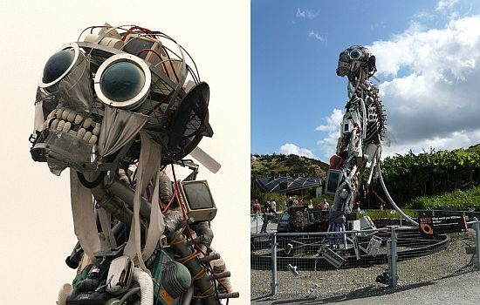
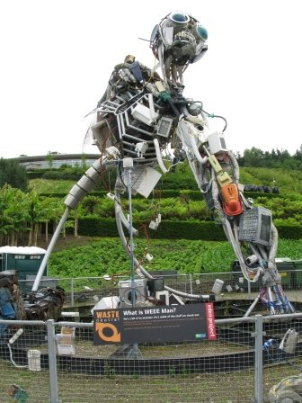

Slide 9
Current trends in global production and consumption patterns are unlikely to change signiﬁcantly, meaning that externalities will increase.
Goods are becoming cheaper and are being transported in ever-bigger amounts from one side of the world to the other.
Even a simple pot of yoghurt may have travelled over 3 000 km by the time it reaches the table and require inputs from several countries for its ingredients, production and packaging.
We replace goods much more quickly than in the past. Unlike our grandparents’ generation, we throw out rather than repair everything from vacuum cleaners to socks.

Slide 10
Corporate Social Responsibility
The idea behind corporate social responsibility that corporations have an obligation to consider the impact of their activities on the environment, economy and society is not exactly new.
How companies treat their employees and what kinds of products they provide to their customers has been the topic of debate for centuries.
In its contemporary version, corporate social responsibility can encompass everything from service to shareholders, community, governance, diversity, employees, environment, and human rights.
A big part is reporting – letting the public and shareholders know about what the companies are doing to fulfill their role as corporate citizens.
This is also a way for corporations to communicate their “good deeds” for public relations purposes.
Third party organizations also produce “report cards” rating corporations on the different aspects of social responsibility.

Slide 11
CSR cont.
The benefits of increased corporate responsibility are clear, but there may also be more ambiguous issues.
Corporate power may also increase along with responsibility.
Corporate social responsibility allows companies to publicise their good actions but can also obscure unsustainable practices in other areas, especially in the case of multinationals with complex supply chains and subcontractors that may or may not be following company guidelines.
The problem with corporate social responsibility, as promoted in the OECD Guidelines for Multinational Enterprises, is that it is voluntary. In some cases, corporations are out in front of governments in terms of addressing climate change and other problems.
But the time is coming when companies will be required by governments to fulﬁll their environmental and social obligations both at home and abroad in the interest of sustainable development.

Slide 12
Role of Technology
Technology might reduce some of the negative impacts on sustainability of production and consumption but it will create others, and technological improvements are often outpaced by growth in consumption
For instance, cars are now much more fuel efﬁcient than before. But air pollution is getting worse because so many more people have cars.

Slide 13
Connecting the Dots
What can be done concretely to promote sustainable production and consumption?
Even quite small actions can have a large cumulative impact.
According to the US Environmental Protection Agency (USEPA), if every home in America replaced just one incandescent light bulb with a compact fluriscentone, in one year enough energy would be saved to light more than 3 million homes and prevent greenhouse gas emissions equivalent to those of more than 800 000 cars.
Most successful efforts influencing markets involve coordinated efforts – where producers, consumers and governments each have a role to play.
Only through the combination of these efforts, old behaviors and processes can be transformed on a large enough scale to make sustainable development a norm.

Slide 14
Coordinating our efforts
How can producers integrate sustainability into product design, manufacture and distribution without sacriﬁcing traditional factors such as proﬁt or brand image?
We can’t really be sustainable consumers without sustainable product choices.
Design is arguably the most inﬂuential single stage in the process, since it determines the rest.
First of all, the design has to consider the product as part of a product system and consumer lifestyle.

Slide 15
Coordination cont.
If a phone integrates a camera and an MP3 player, will users then buy only the phone, saving the environmental and other costs of manufacturing three separate products?
Or will they also buy the others, adding to the burden?
Design also means choosing the materials from which the product will be made.
Can the product be designed in such a way as to maintain the required physical properties while using fewer materials?
Could it be made of renewable, recyclable materials?
Design also inﬂuences manufacturing by determining the number of steps in the production process.

Slide 16
Coordination cont.
Questions speciﬁc to manufacturing can involve how to reduce energy consumption or pollution, or how to improve worker safety.
Once the product is made, what is the most sustainable way to package it for shipping and sale?
Should it be transported by air, sea or land, by rail or truck?
Design and manufacturing play a big part in determining how long something will last, how many other products it will need to work (e.g. batteries) and if it can be repaired or maintained.
Finally, producers also have to think about what happens to the product at the end of its life cycle.
Once again, good design can make a difference. Are the materials used easy and safe to recycle for example? Can parts of the product be refurbished and reused?

