Slide 1
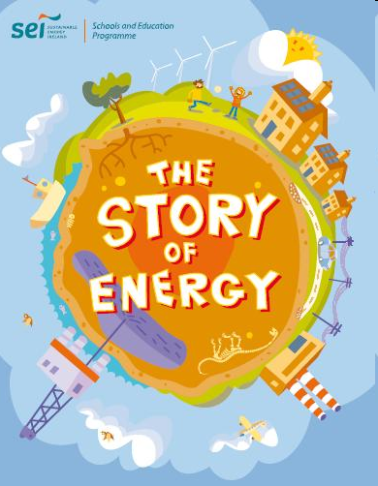
Energy & Environment

Slide 2
What is Energy?
Energy is the capacity for doing work.
There are various forms of energy such as potential, kinetic, heat, light, sound, electricity, magnetism, chemical, nuclear, etc.
There are two kinds of sources :
    Non-renewable, and
    Renewable

Slide 3
Strategic challenges to global energy system
The global energy system faces three major strategic challenges in the coming decades:
growing risk of disruptions to energy supply;
threat to environmental damage caused by energy production and use;
persistent energy poverty.
The first two challenges have attracted a lot of attention from the energy-economics community, much less so the need to address the problem of energy under-development.

Slide 4
Non-renewable Sources
Fossil fuels such as coal, oil and gas are examples of non-renewable sources because they are not going to last forever.
It has been predicted that coal, the cheapest of the three may last for another 300 years whereas oil and gas will be finished by the middle of the century.
Another disadvantage is that they emit greenhouse gases which we are all familiar with.
- It takes perhaps a 100 million years for natural processes to produce useful amounts of petroleum, natural gas, or coal.

Slide 5
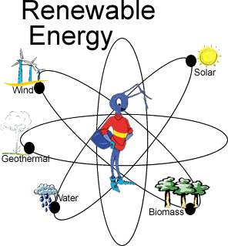
Renewable Source
Renewable energy sources are the ones from which energy can be harnessed without depletion.
They are generally regarded as environmentally benign.
Examples are: solar, nuclear, wind, wave, tidal, oceanic, hydropower, geothermal, biomass, hydrogen and fuel cell.

Slide 6
Solar Energy
The sun serves as a giant nuclear furnace in space, constantly bathing our planet with lot of energy.
The average amount of solar energy arriving at the top of the atmosphere is 340 watts/sq. m.
About half of this is absorbed or reflected by the atmosphere.

Slide 7
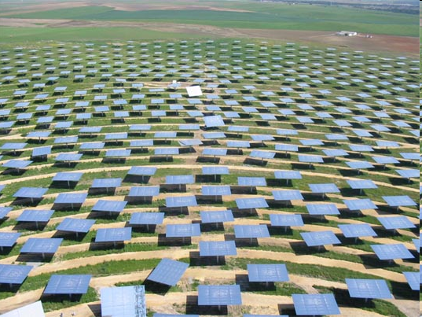
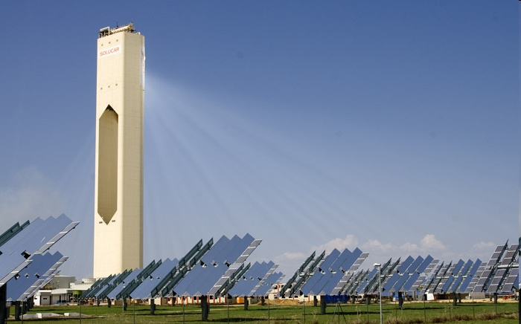
Harnessing Solar Power

Slide 8
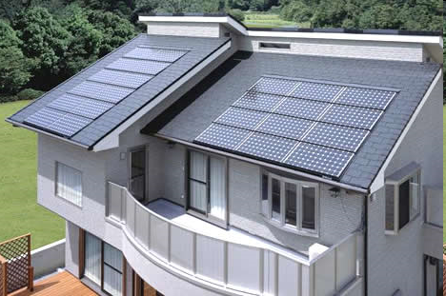
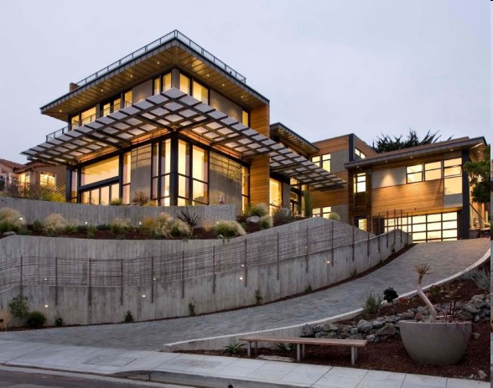
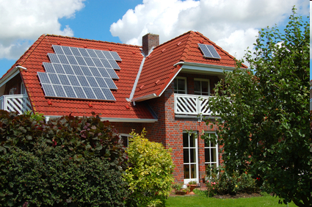

Solar Homes

Slide 9
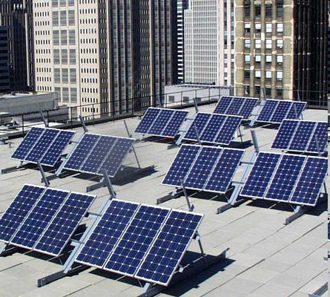
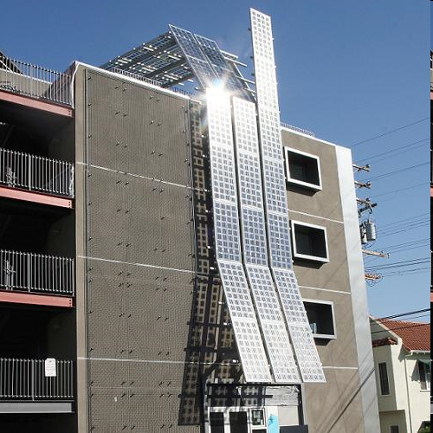
Solar Apartments

Slide 10
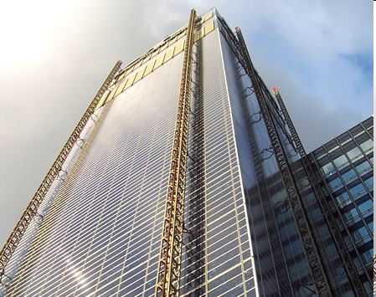
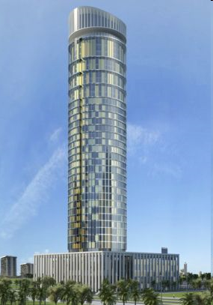
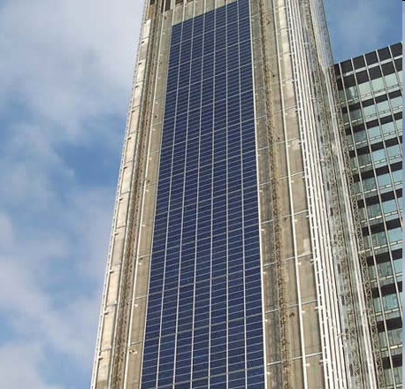
Solar Tower

Slide 11
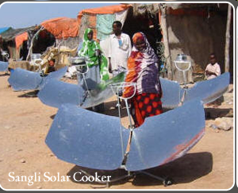
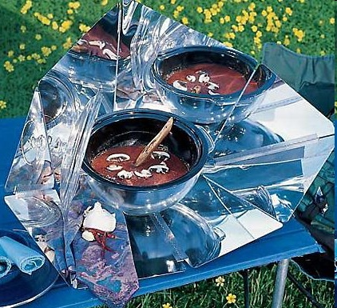
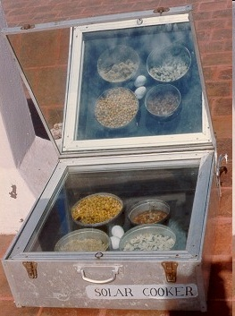
Solar Cooker

Slide 12
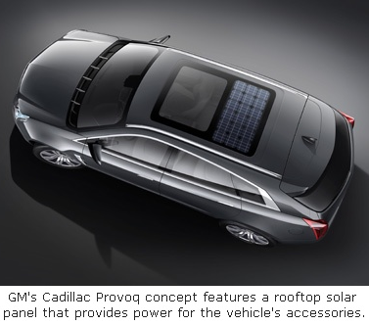
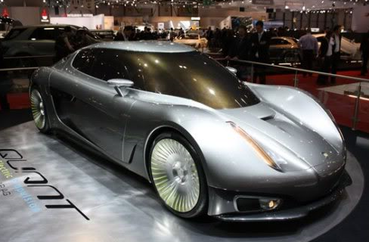
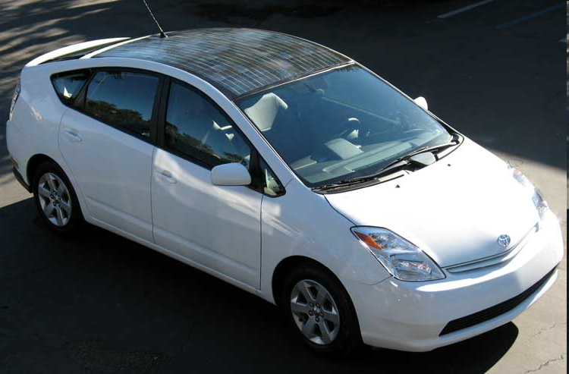
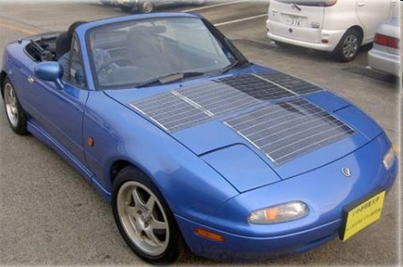
Solar Car

Slide 13
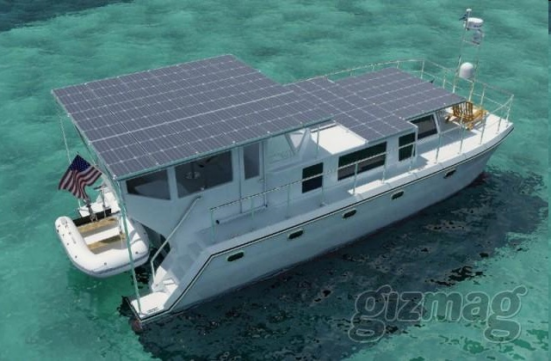
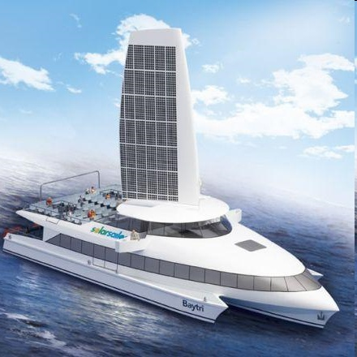
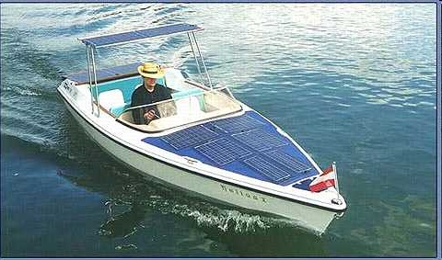
Solar Ship/Boat

Slide 14
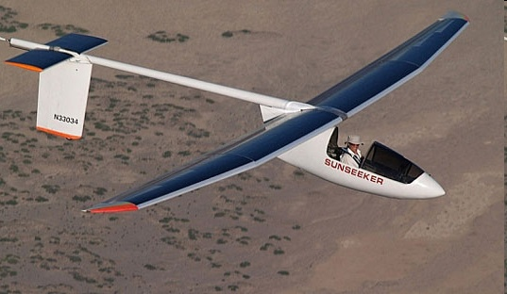
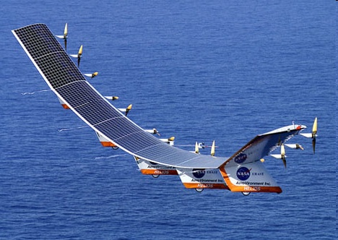
Solar Aeroplane

Slide 15
Hydroelectric Power
Flowing water creates energy that can be captured and turned into electricity.
This is called hydroelectric power or hydropower.
The most common type of hydroelectric power plant uses a dam on a river to store water in a reservoir.
Water released from the reservoir flows rotates a turbine producing electricity.
A turbine is a rotary engine that extracts energy from a fluid flow and converts it into useful work. (Source : Wikipedia)

Slide 16
Hydroelectric Power cont.
At present hydroelectricity produces about 6% of the world’s energy supply or about 15% of the world’s electricity.
Mountainous regions and large river valleys are the prerequisites for the potential hydropower.
China alone possesses one-tenth of the world’s potential.

Slide 17
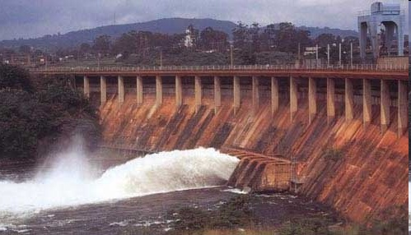
Hydroelectricity cont.
Europe, Japan, USA, Canada, the eastern part of the former Soviet Union are at the forefront of utilizing this potential.
Norway gets 99% of its electricity from falling water.
Some of the famous dams are : Three Georges Dam in China, Itaipu in Brazil and Paraguay, Aswan in Egypt etc.
The hydroelectric power station of Aswan Dam, Egypt

Slide 18
Environmental & Social Effects
The most obvious impact of hydroelectric dams is the flooding of vast areas of land, much of it may have been inhabited by people or forested or used for agriculture.
The construction of the Aswan Dam in Egypt resulted in the displacement of 80000 people.

Slide 19
Effects cont.
Recent studies suggest that decaying vegetation, submerged by flooding, may give off greenhouse gases.
Damming a river can alter the amount and quality of water in the river downstream of the dam, as well as prevent fish from migrating upstream to spawn.

Slide 20
Kaptai Dam

Slide 21
Wind Power
For centuries, wind has been used to move ships, grind grains, pump water and do other forms of work.
The large sailing vessels of the 19th century could extract as much as 10,000 horsepower from the wind.
In more recent times wind has been used to generate electricity.

Slide 22
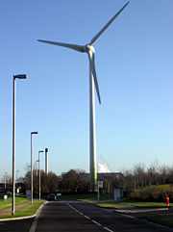
Wind Power cont.
Since 1998, wind power has been the fastest-growing new source of electricity in the world, expanding an average of 30% a year.
Denmark, a world leader in wind turbine technology and manufacture, is getting 15% of its electricity from wind power.
A wind turbine at Greenpark, Reading, England, producing electricity for around one thousand homes

Slide 23
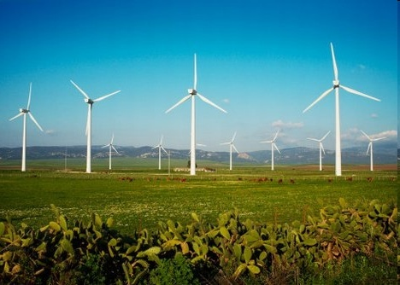
Wind Power cont.
Wind generators do have some negative effects.
The moving blades are a hazard to birds and produce a noise that some find annoying.
Vibrations from the generators can also cause structural problems.

Slide 24
Wave Energy
Favorable areas for the exploitation of wave energy are located especially in latitudes in the ranges of 40-60⁰N and 40-60⁰S, where the winds blow strongest.
These areas include the western coastlines of Norway, Scotland and the USA and the eastern coastline of Japan.

Slide 25
Wave Energy cont.
Wave technology is undergoing research only in a very few countries, principally Norway and Japan.
There are many problems including :
  High costs,
  Corrosion by sea water and storm damage to equipment, and
  The intermittent nature of this renewable source of energy.

Slide 26
Wave Energy cont.
The only current commercial use of wave-produced electricity is to supply remote lighthouses and navigational buoys; the latter are extensively used in Japan.
A prototype 500kW power station has been providing electricity for the Norwegian national grid since 1985.

Slide 27
Tidal Energy
More recently, rising and falling tides have been used to generate electricity in much the same manner as hydroelectric power plants.
To produce practical amounts of power, a difference of at least 5 meter is required between high and low tides.
About 40 sites around the world have this magnitude of tidal range.

Slide 28
Tidal Energy cont.
Tidal power plants involve building a barrage equipped with sluice gates and turbines usually across a narrow neck of water.
These can be designed to generate electricity on the ebb tide only, or on both the ebb and flood tides, known as `two-way generation’.
Tidal power is expensive and only a few stations are in operation.

Slide 29
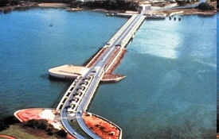
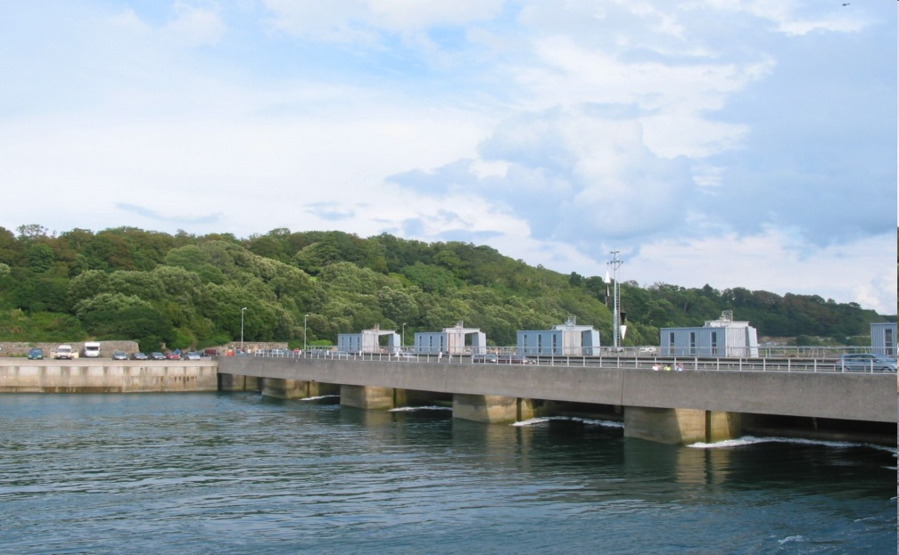
Tidal Energy cont.
The biggest one is the 240 MW generating station built at the mouth of the La Rance river estuary on the northern coast of France, operating since 1966.
Rance tidal power plant

Slide 30
Tidal Energy cont.
The environmental effects of tidal projects are considerable and must be individually assessed. They include negative effects on:
  Ports,
  Navigation,
  Wildlife and recreation

Slide 31
Biomass
Biomass is plant and animal material that can be used for energy.
This includes using wood from trees, waste from other plants (for example, bagasse from sugar cane) and manure from livestock.
Biomass can be burned directly as a source of heat for cooking, burned to produce electricity, converted to alcohol, or used to generate methane.

Slide 32
Biomass cont.
Many different types of biomass can be grown for the purpose of energy production.
Crops that have been used for energy include sugarcane, corn, sugar beets, grains, kelp, and others.
There are basically 3 distinct sources of biomass energy :
  Municipal & Industrial wastes
  Agricultural crop residues and
  Energy plantation

Slide 33
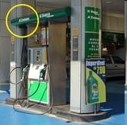
Biomass Energy: Ethanol
Many countries produce alcohol from biomass. But Brazil is the largest producer, mainly from sugarcane.
Alcohols provide 50% of Brazil’s automobile fuels.
A typical Brazilian fueling pump at São Paulo city, Brazil
The pump has dual capacity for dispensing ethanol (A for alcohol) and gasoline (G). Drivers are literally free to choose any amount they wish for each fuel.

Slide 34
Biofuel cont.
However, there has been considerable debate about how useful bioethanol will be in replacing gasoline.
This include :
  Increased food price
  Requirement of large amount of arable land

Slide 35
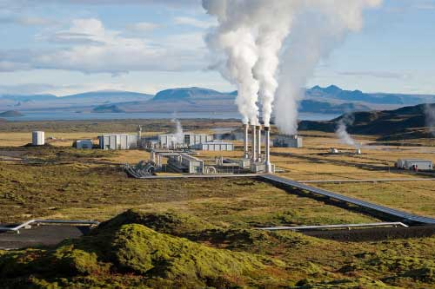
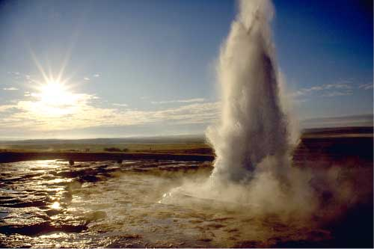
Geothermal Energy
Geothermal energy uses heat energy from beneath the surface of the earth.
Some of this heat finds its way to the surface in the form of hot springs or geysers.
Geothermal energy is used for the generation of electricity and for space and water heating in a small number of countries.
A natural geyser and a geothermal power plant in Iceland

Slide 36
Energy Resources in Bangladesh
Traditional energy sources (rice stalks and husks, scrub wood and animal dung, direct thermal energy from sun) ~ 70%
Commercial energy sources (Natural gas, oil, coal, hydropower) ~ 30%
Prospect of Renewable Energy in Bangladesh?

Slide 37


